Slide 1
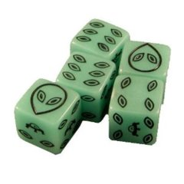
Van Fraassen vs. IBE
Kareem Khalifa
Philosophy Department
Middlebury College

Slide 2
Overview
Induction’s Failures
Objections to IBE

Slide 3
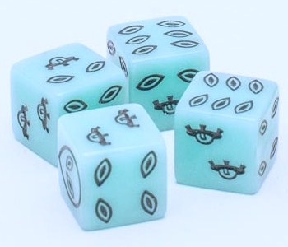
1. Induction’s Failures
1.1. Why accept IBE?
1.2. What’s wrong with Ideal Horizontal Induction?
1.2.1. Alien die
1.2.2. Complexity

Slide 4
2. Van Fraassen’s Objections
2.1. Bad Lots
2.2. Privilege
2.2.1. Evolution
2.2.2. Theism
2.3. Force Majeure
2.4. Retrenchment
2.4.1. Simplicity

